Slide 1

Akita state management
Davy
<Dec><2021>
CONFIDENTIAL | © 2021 EPAM Systems, Inc.

Slide 2

Agenda
Introduction
Akita-store
Akita-query
Design thinking
Demo
Comparison
Notes:
Greeting everyone
Define topic
Preview agenda

Slide 3
Introduction
A Reactive State Management Tailor-Made for JS Applications
Notes:
Mentioned other state management
Akita introduce. Datorama

Slide 4
Akita-store
const store = Akita.createStore(initialState, options)
store.update({...})
store.setLoading(true)
store.restore()
...
Notes:
All have store。
Explain store in akita

Slide 5
Akita-query
const query = Akita.createQuery(store)
query.selectAll()
query.select('name')
query.select(['name', 'age'])
Notes:
Query special
Explian query
Good at for now

Slide 6
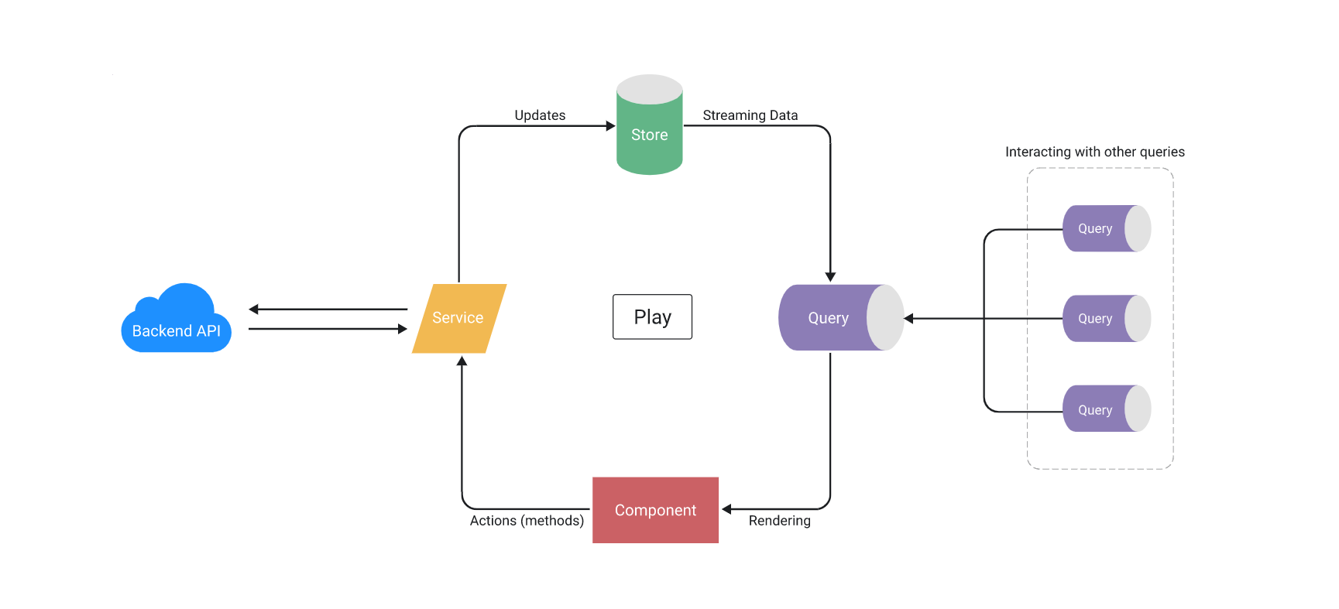
Design thinking
const query = Akita.createQuery(store)
query.selectAll()
query.select('name')
query.select(['name', 'age'])
Notes:
Service layer do actions by call store functions
Component rendering by get state from query

Slide 7
Akita-query
 | Performance | Community | Learning Curve
redux | Solid Speed/Performance even with large amounts of data | Most used option so a lot of examples/resources online Well Supported | Large Learning Curve A lot of boilerplate
akita | Poor Speed/Performance | Not as common so less resources/examples | Simple/Small Learning Curve Little to no boilerplate Great for small to medium sized apps Rxjs seamless API mostly like CRUD

Slide 8
Thank You

